Slide 1
From Zero to GeoHero Integrating Geospatial Data into Your Applications

Slide 2








Thank you to our Sponsors!

Slide 3

Presentation Files
https://github.com/bckent
Repo: devup-2025-geospatial-development

Slide 4

BRANDON KENT
Based in Kansas City, Missouri
20+ years in tech
https://www.linkedin.com/in/brandon-kent-3806992/
Wife, 2 daughters, 2 cats
Always excited to chat about:
- Energy-efficient building standards
- Vacuum tube technology
- Cats 🐱

Slide 5


About MY EMPLOYER
Working from more than 75 offices around the world, Burns & McDonnell designs and builds critical infrastructure. Global team of engineers, construction professionals, architects, planners, technologists and scientists
1898 & Co. is a global practice within Burns & McDonnell that focuses on business, technology and security consultancy serving critical infrastructure industries.

Slide 6
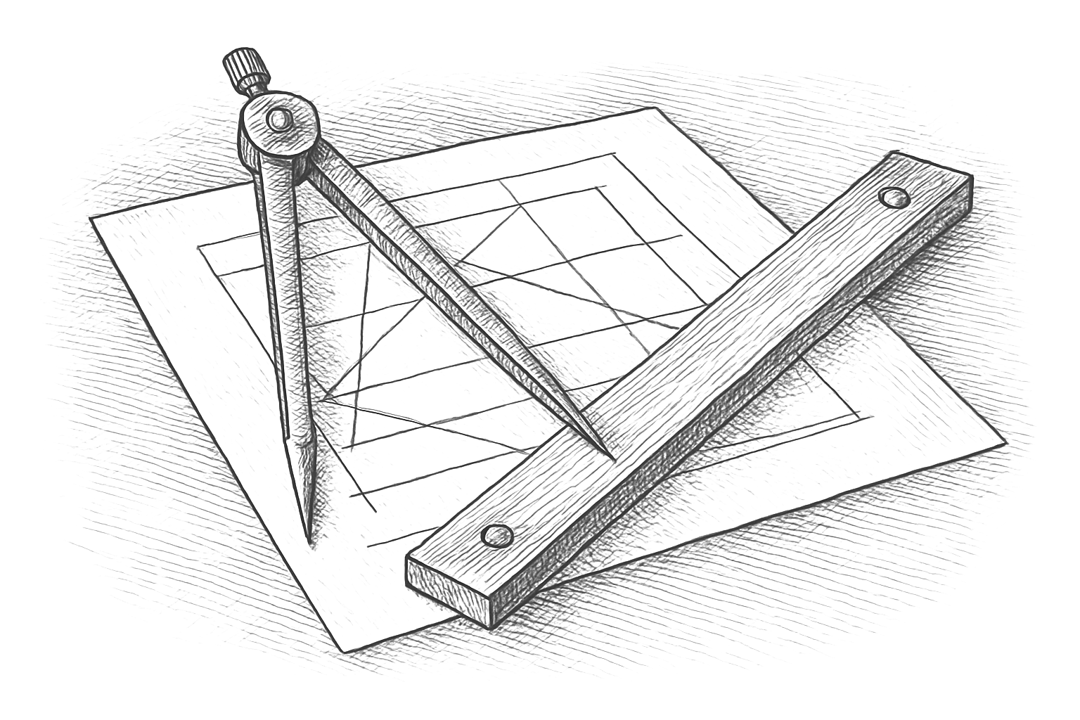
About THIS TALK
Developer-focused introduction to using geospatial capabilities in software
Spatial concepts
Spatial data and databases
App Development
Interesting tools and services

Slide 7
FOUNDATIONAL CONCEPTS

Slide 8
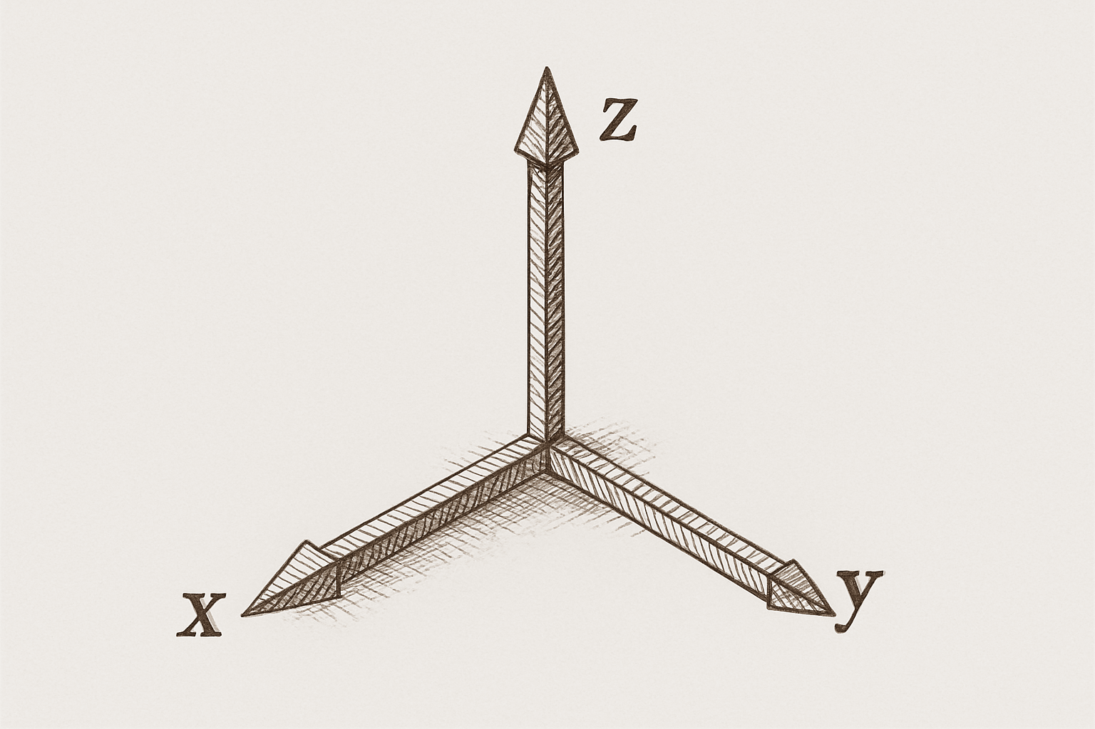
GEOMETRY
Geometry is the study of shapes, sizes, relative positions, and properties of space.
Key Concepts
- Points, lines, polygons
- Distance, area
- Spatial relationships
- Coordinate systems

Slide 9

GEOGRAPHY
Geography is the study of the Earth's physical features and the human-made structures that interact with these features.
Key Concepts
- Terrain, climate, landforms, oceans
- Human-environment interactions
- Real world locations

Slide 10
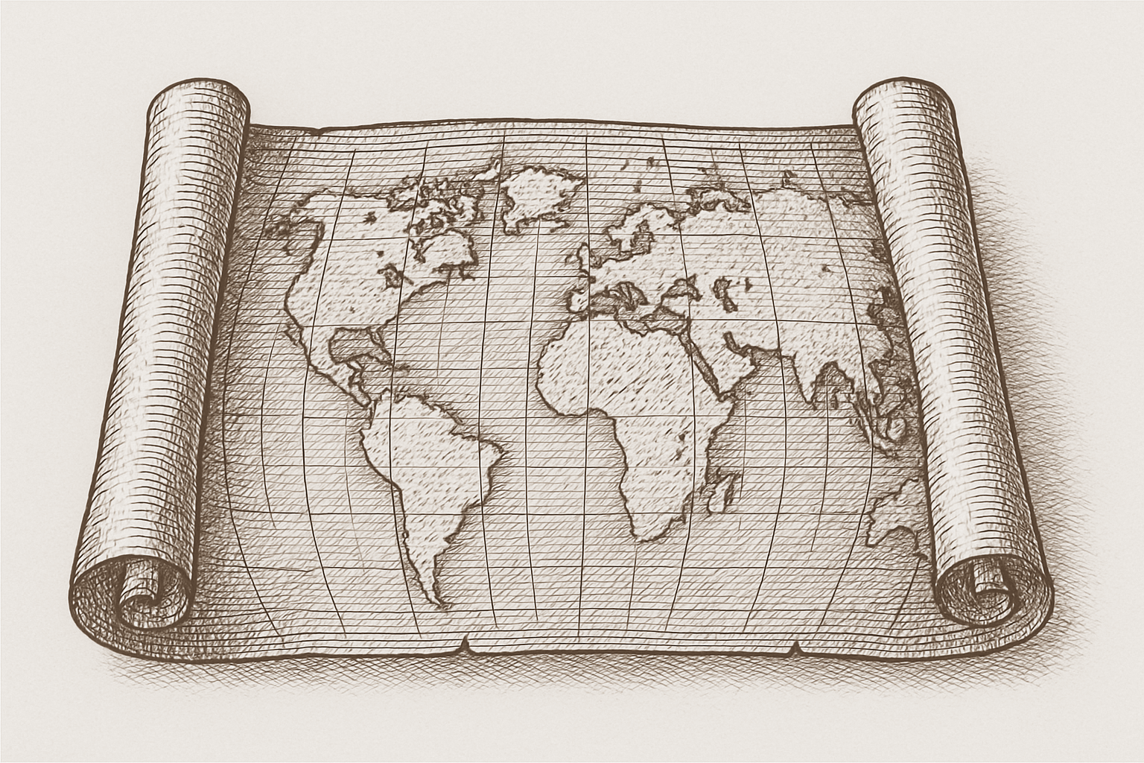
CARTOGRAPHY
Cartography is the science and practice of making maps.
Key Concepts
- Projection of the 3D earth onto 2D surface
- Map symbols, legends, labels
- Turning raw geographic and geometric data into meaningful, accessible maps

Slide 11
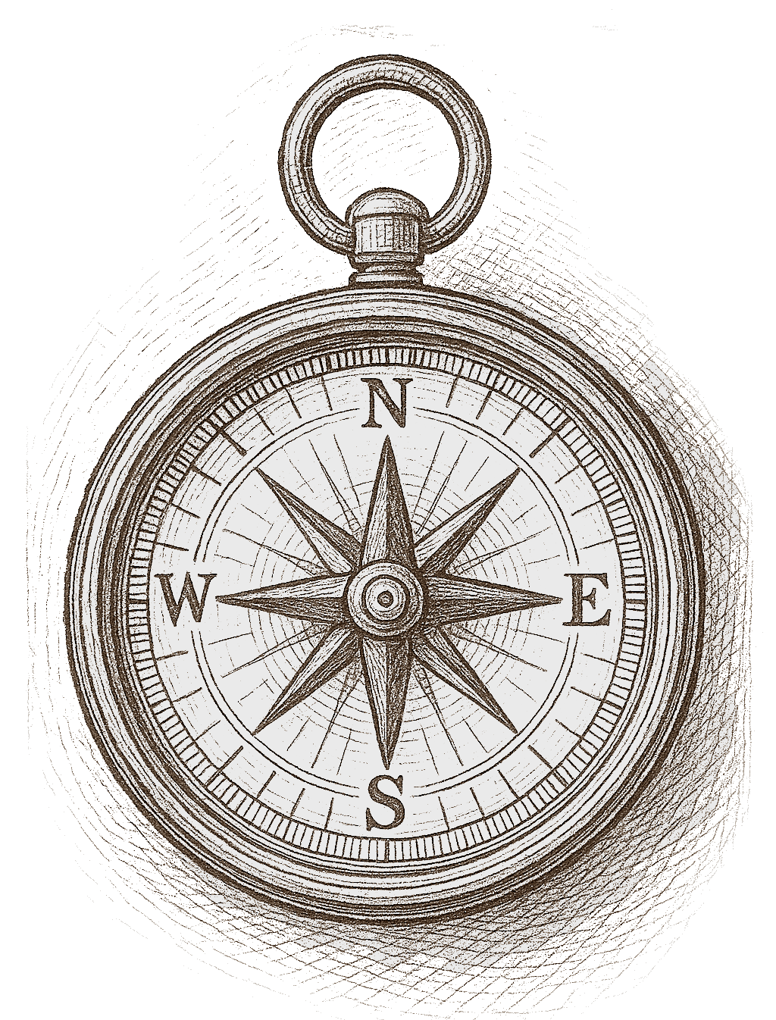
Geospatial CAPABILITIES
Displaying Imagery
Mapping Geospatial Data
Spatial Data Analysis & Transformation
Geocoding
Geolocation
Point of Interest
Routing
Time-Variant Data

Slide 12
Industries using Geospatial Data
Agriculture
Automotive
Construction & Engineering
Emergency Management
Energy
Forestry & Land Use
Government
Insurance
Logistics
Maritime
Meteorology
Military
Politics
Public Safety
Real Estate
Space
Sports & Recreation
Transportation & Delivery

Slide 13
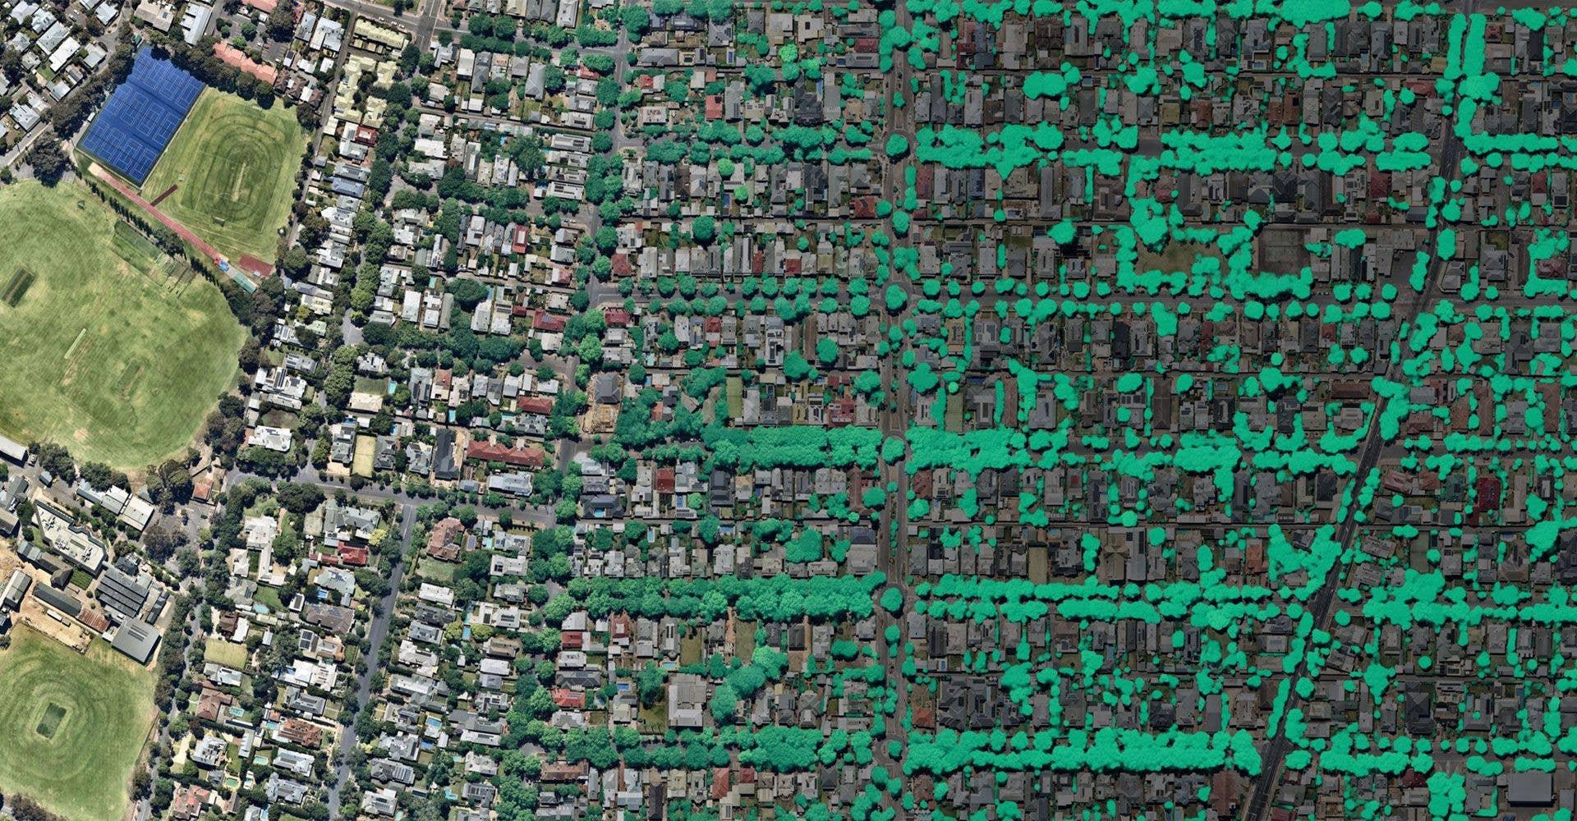
REAL-WORLD APPLICATIONS
An electrical utility processing LIDAR imagery using machine learning models to estimate foliage growth to better manage vegetation near transmission and distribution lines

Slide 14
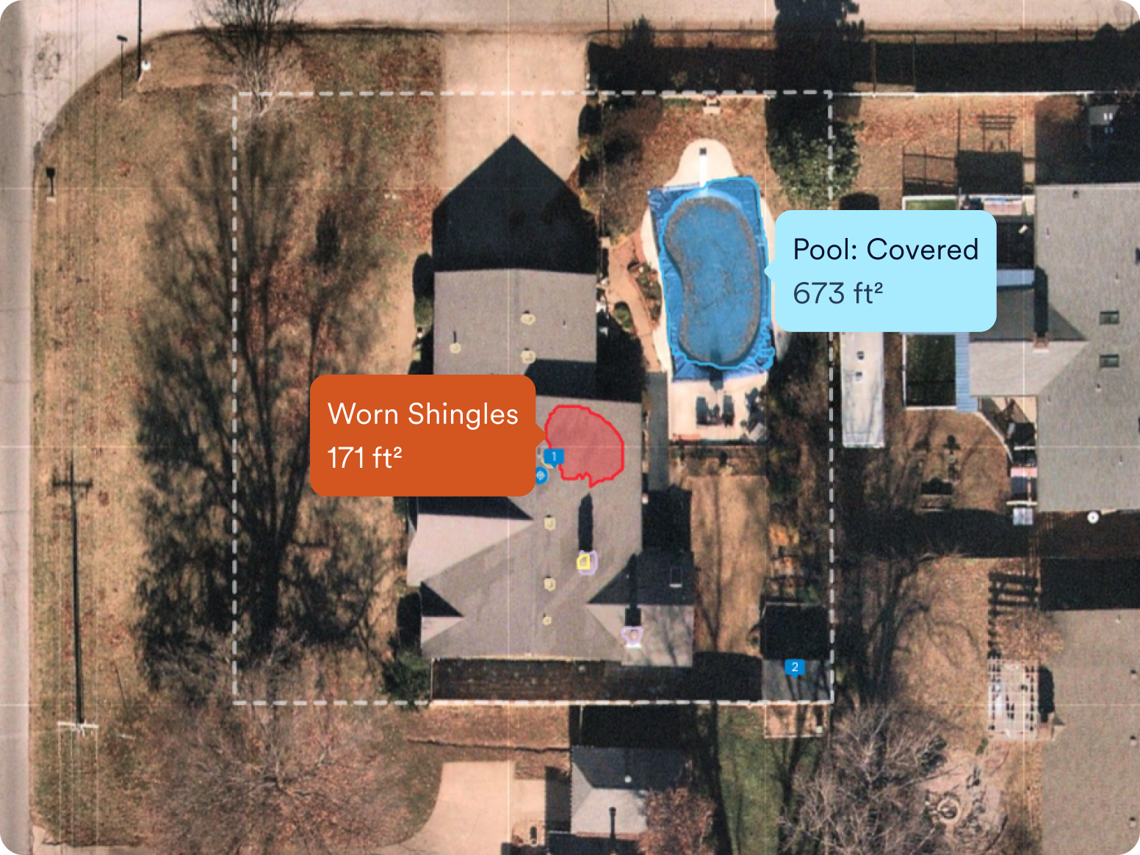
REAL-WORLD APPLICATIONS
An insurance company integrating satellite imagery with AI to assess roofing condition and other policy risks.

Slide 15
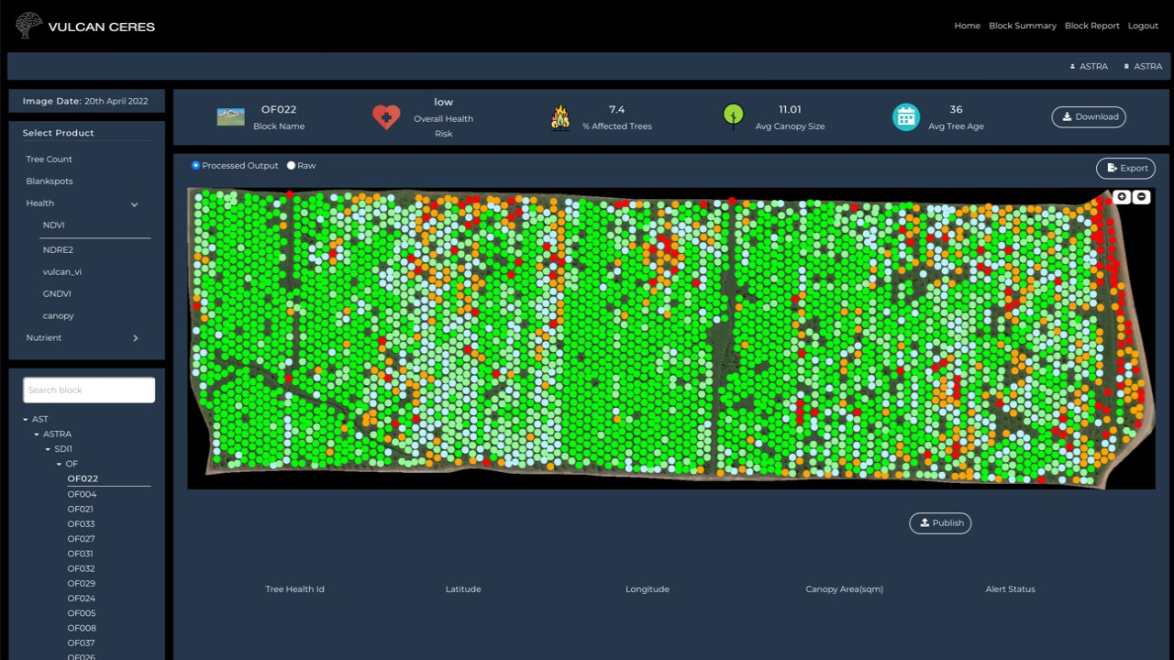
REAL-WORLD APPLICATIONS
An AI-powered agriculture platform combining satellite imagery, drone data, and IoT sensors to monitor crop health, detect pests and nutrient deficiencies, and optimize harvesting, helping farmers increase yields while reducing costs and resource usage.

Slide 16
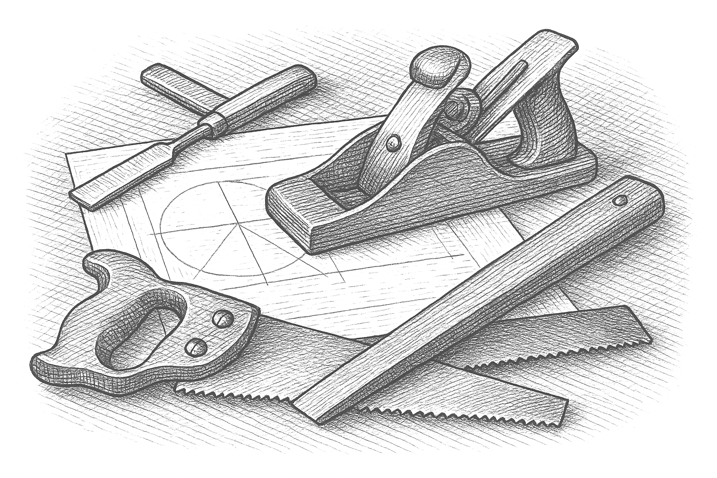
BUILDING BLOCKS

Slide 17
What is Geospatial Data?
Feature Collection
- Metadata
- Source, attribution
Feature
- Spatial Data: Geometry defining the shape
- Non-Spatial Data: Descriptive attributes
Labeling & Styling
- How the feature(s) should be symbolized or labelled

Slide 18
{
"type": "FeatureCollection",
"features": [
{
"type": "Feature",
"geometry": {
"type": "Point",
"coordinates": [-73.9857, 40.7484]
},
"properties": {
"name": "Empire State Building",
"type": "Building",
"height": 443.2,
"year_built": 1931,
"address": "350 5th Ave, New York, NY 10118"
}
}
]
}

Slide 19
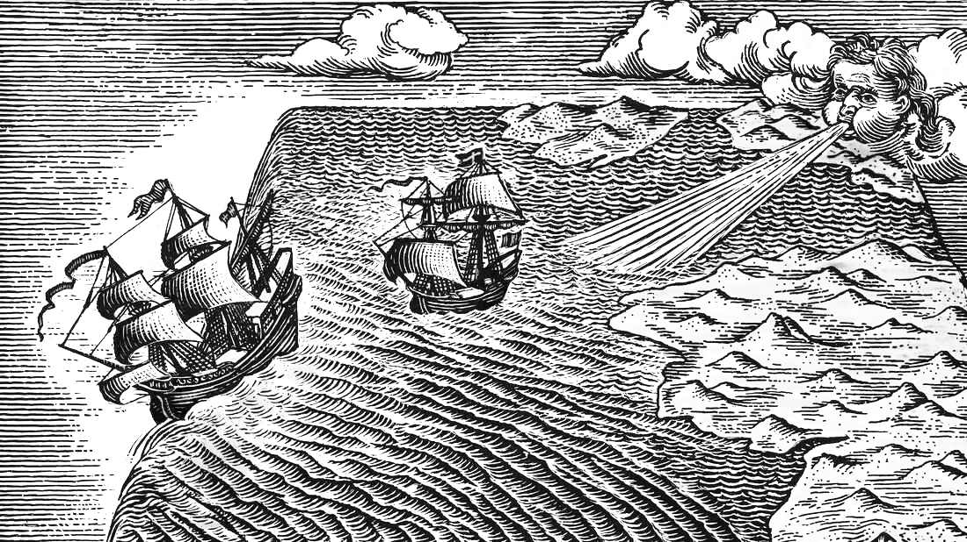
COORDINATE SYSTEMS

Slide 20
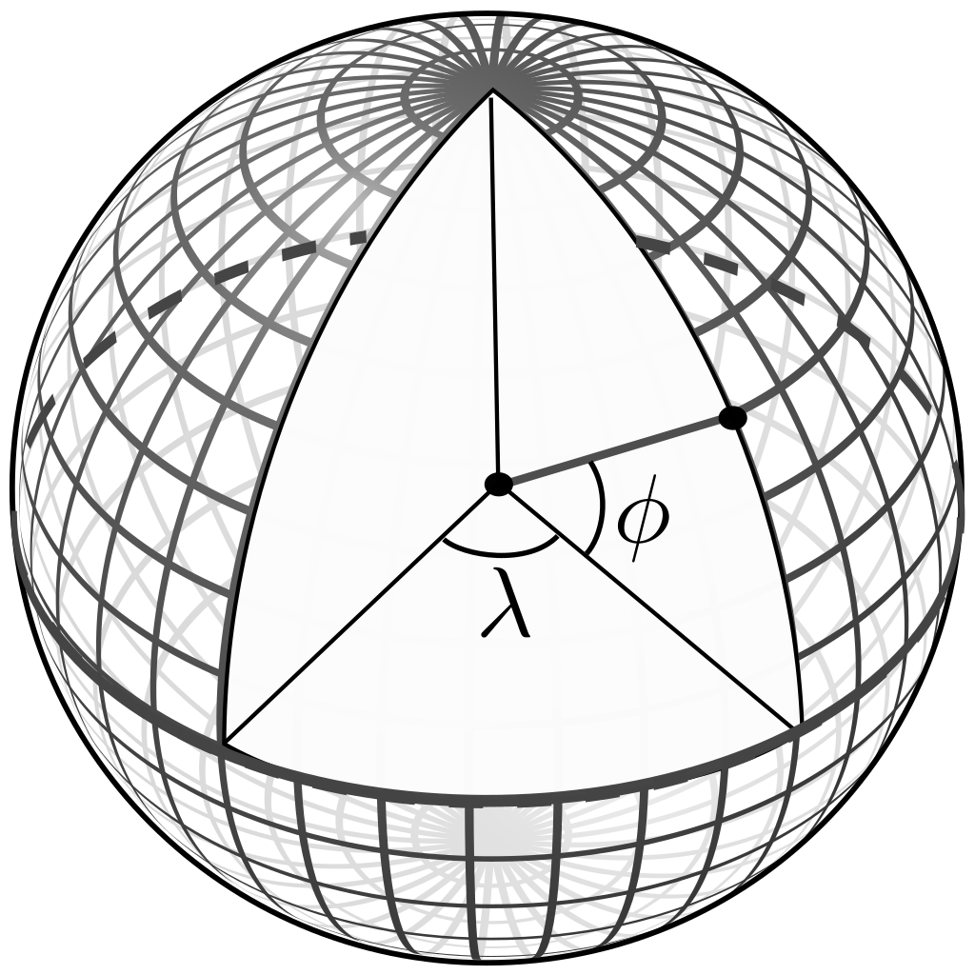
Latitude & Longitude
Geographic coordinate system
- Polar coordinates originally based on spherical globe model
- Latitude: North/South
- Longitude: East/West
- Equator, prime meridian

Slide 21
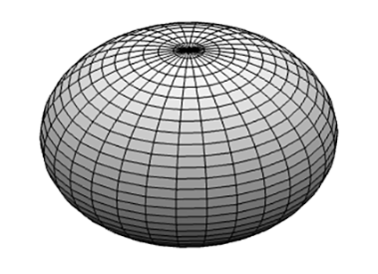
INTRO TO PLANETARY GEODETICS
Oblate Spheroid
- Rotational ellipsoid about the minor axis
- “Pumpkin” shape
Reference ellipsoid
- Mathematically defined, idealized, smooth, oblate spheroid that approximates the shape of the Earth
- Earth’s equatorial bulge is caused by centrifugal force due to rotation

Slide 22
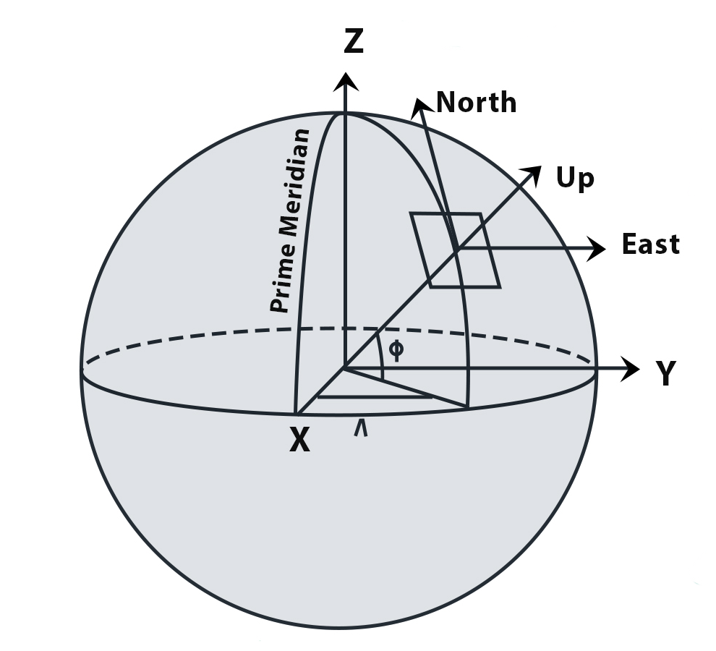
Spatial REFERENCE SYSTEMS
WGS 84 – World Geodetic System
WGS 84 is the global geodetic reference system used by GPS
It uses an oblate spheroid reference ellipsoid centered at the Earth's center of mass.
The WGS 84 prime meridian is nearly aligned with the IERS Reference Meridian, but there is a small offset from the historical Greenwich line.
EPSG:4326 is the WGS 84 latitude/longitude coordinate system (unprojected, degrees-based)

Slide 23
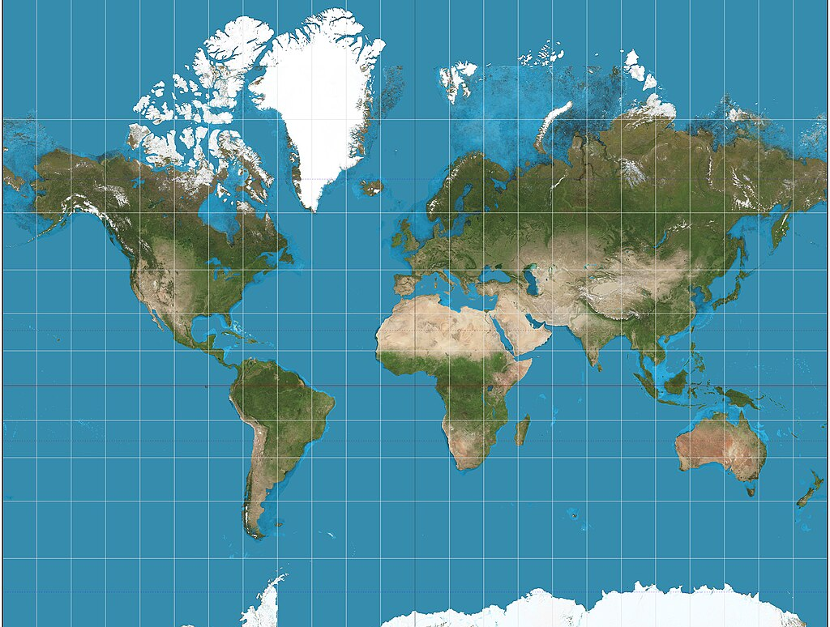
The WORLD ISN’T FLAT, BUT MAPS ARE

Slide 24
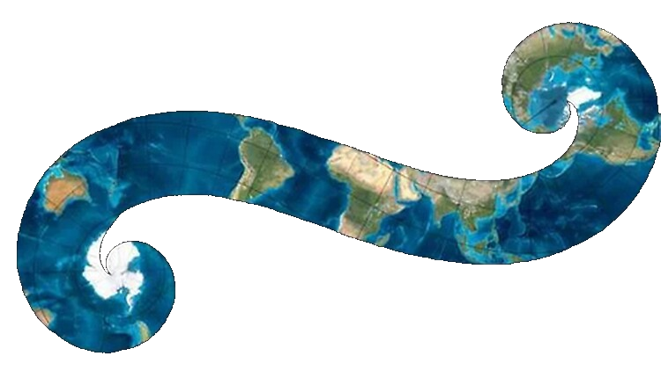
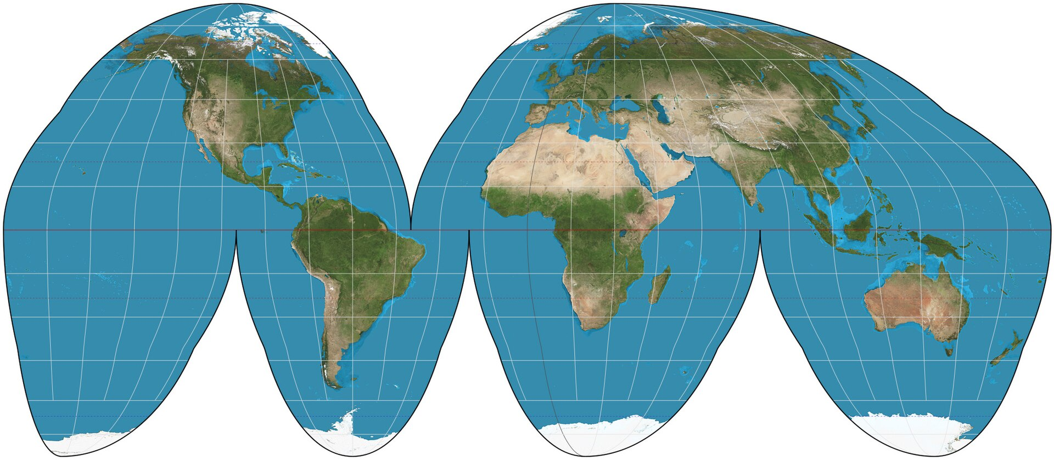
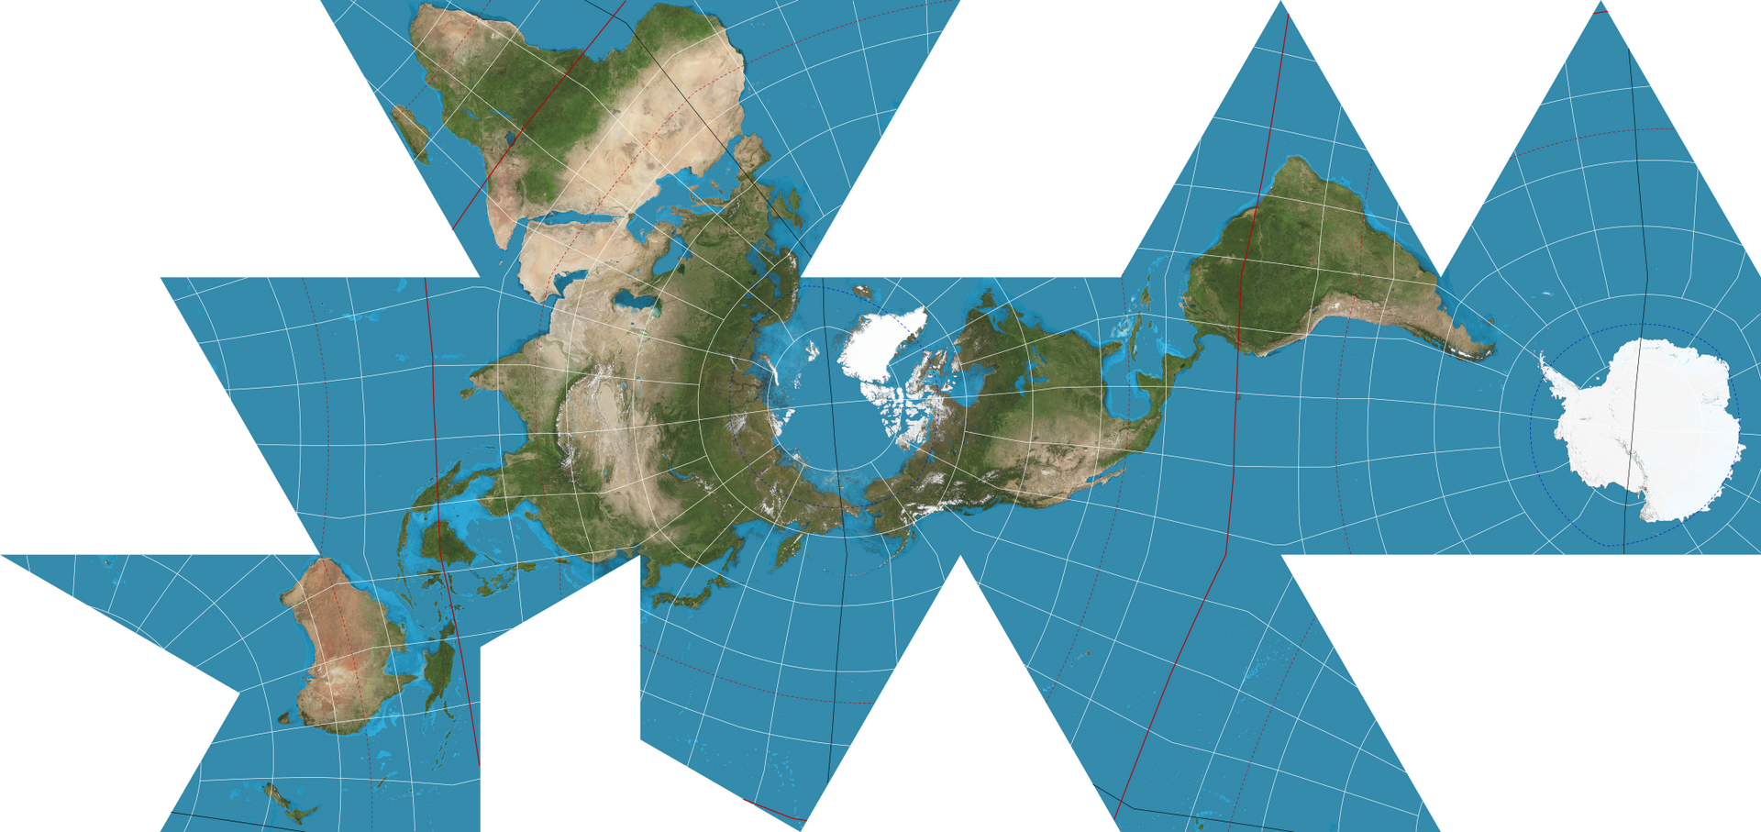
PROJECTIONS
A map projection is a set of transformations used to present a globe surface on a plane.

Slide 25
PROJECTIONS
All projections involve distortion
Types of Distortion:
Direction, Shape, Area, Distance, Shortest Route
Web Mercator
The Web Mercator projection is the most widely used map projection in web and mobile mapping applications, including platforms like Google Maps and OpenStreetMap. It translates latitude and longitude into x/y coordinates on a 2D grid, making it easy to render maps using simple square tiles.

Slide 26
Projected Coordinate SYSTEMS
A projected coordinate system is a type of spatial reference system that represents locations on Earth using Cartesian coordinates (x, y) on a planar surface created by a particular map projection.
Define: map projection, datum, origin point, UOM
Projected coordinate systems
- Web Mercator (EPSG:3857)
- State plane coordinates
Distortion is inevitable!

Slide 27

IF You've MADE IT THIS FAR
This use case is very common!
- Latitude / longitude data
- Web Mercator
Libraries are mature and feature-rich, doing all the heavy lifting
There is plenty of math/science behind geography & geodetics if you are interested.
For everyday development, you don’t have to master all the theory to be productive.

Slide 28
VECTOR Spatial Data Formats
GeoJSON, TopoJSON
KML / KMZ
GeoTIFF
JPEG (geotagged)
GPX
ESRI
File Geodatabase
Shapefile
ESRI-JSON

Slide 29
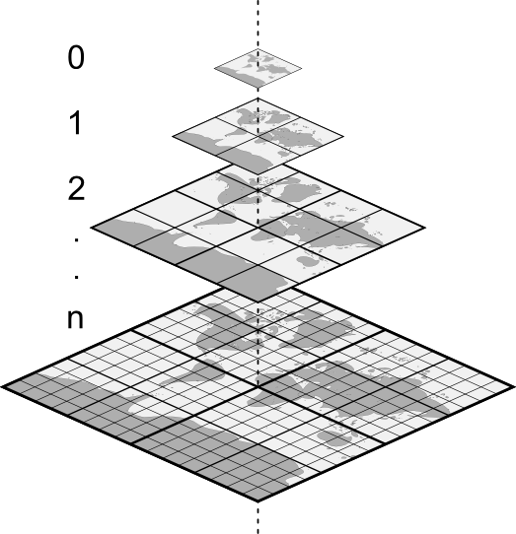
TILED SERVICES
Tiling scheme organizes rendered images into a pyramid-structure of regular grids.
https://www.example.com/tiles/{z}/{x}/{y}.png
Z: Zoom level
X: Column
Y: Row
Tiles can be cached or rendered on-demand

Slide 30
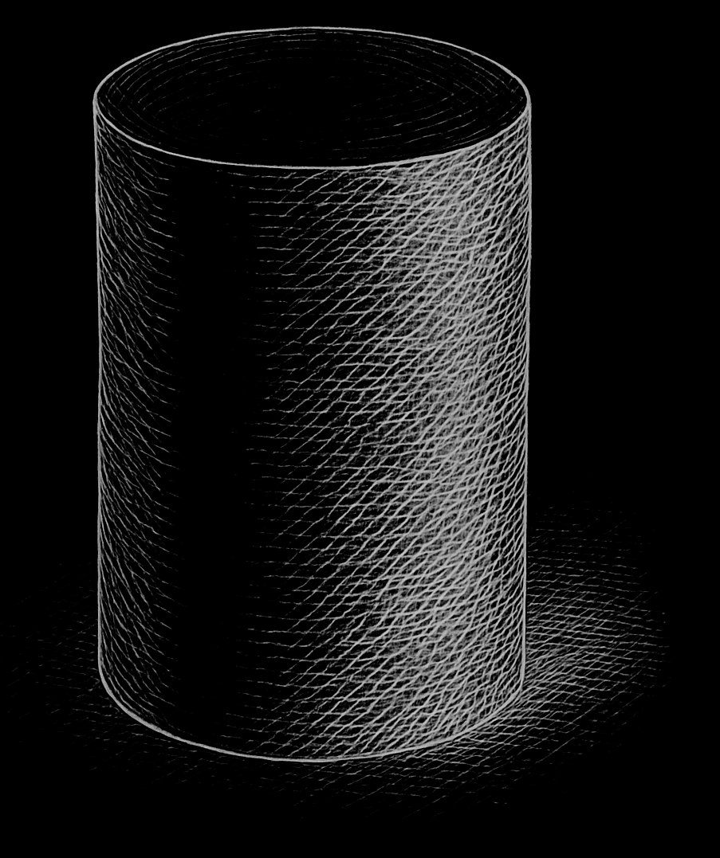
DATA STORAGE

Slide 31
Where to store your spatial data?
Database
PostgreSQL (PostGIS), Oracle Spatial and Graph
Microsoft SQL Server
Others
Blob
AWS S3 or Azure Blob

Slide 32

PostgreSQL & Postgis
"PostgreSQL is a powerful, open source object-relational database system with over 35 years of active development that has earned it a strong reputation for reliability, feature robustness, and performance.”
“PostGIS extends the capabilities of the PostgreSQL relational database by adding support for storing, indexing, and querying geospatial data.”

Slide 33
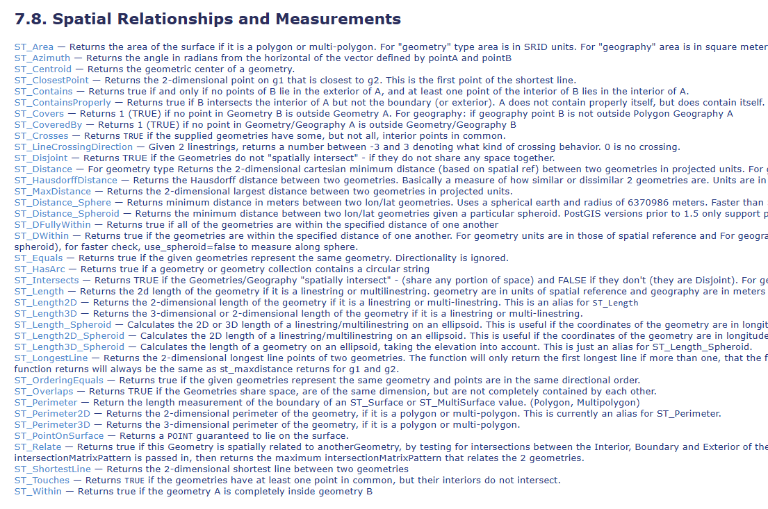
Postgis

Slide 34
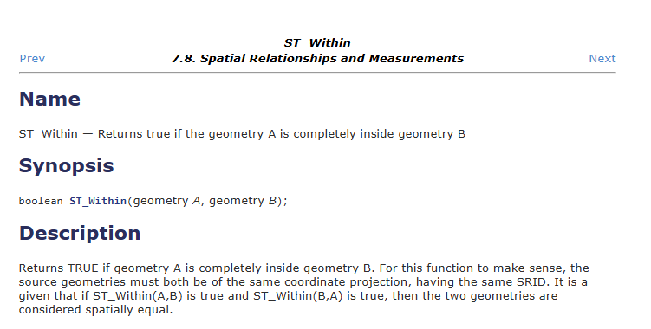
Postgis

Slide 35
DEMO

Slide 36

APP DEVELOPMENT

Slide 37
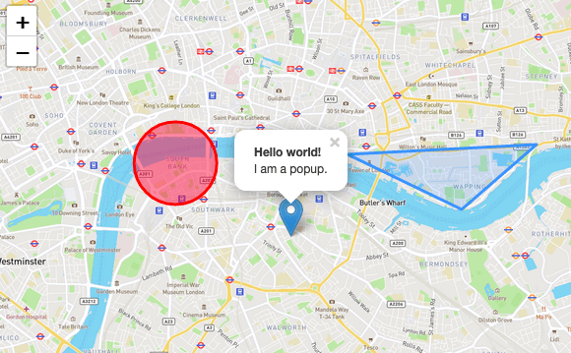
TILED WEB MAP

Slide 38
TILED WEB MAP
Web Map Library
- Loading layers
- Map controls (pan/zoom)
- Interactions (picking)
Base map
- Aerial, road, hybrid, terrain, etc.
Geospatial Data
- Sourced from API?

Slide 39
WEB MAP LIBRARIES
OpenLayers
Leaflet
CesiumJS
Mapbox GL JS / MapLibre GL JS
ESRI ArcGIS SDK for JavaScript

Slide 40
MAP DATA SERVICES
Azure Maps
Bing
Google
HERE!
MapBox
ESRI

Slide 41
Other Tools
GDAL
GDAL is an open-source library for reading, writing, and manipulating geospatial data formats, such as GeoTIFF, Shapefile, and GeoJSON. It provides a unified interface for working with raster and vector data across different file formats, making it essential for spatial data processing tasks. Developers can use GDAL to perform tasks like format conversion, spatial analysis, and data extraction in geospatial applications.
Geoserver
GeoServer is an open-source server for sharing and editing geospatial data, designed to publish maps and data in a variety of formats, including WMS, WFS, and WCS. It integrates easily with spatial databases like PostGIS, enabling developers to serve dynamic, real-time geospatial data over the web. GeoServer is widely used for building web mapping applications and sharing geospatial resources in a standardized way.

Slide 42
Other Tools
FME by Safe Software
FME Flow is a cloud-based platform for automating geospatial data workflows, allowing users to integrate, transform, and publish spatial data with ease. It provides a visual interface for designing data pipelines and supports a wide range of formats, including GIS, CAD, and 3D data. Developers can leverage FME Flow to streamline data processing tasks and enable seamless collaboration in cloud environments.

Slide 43
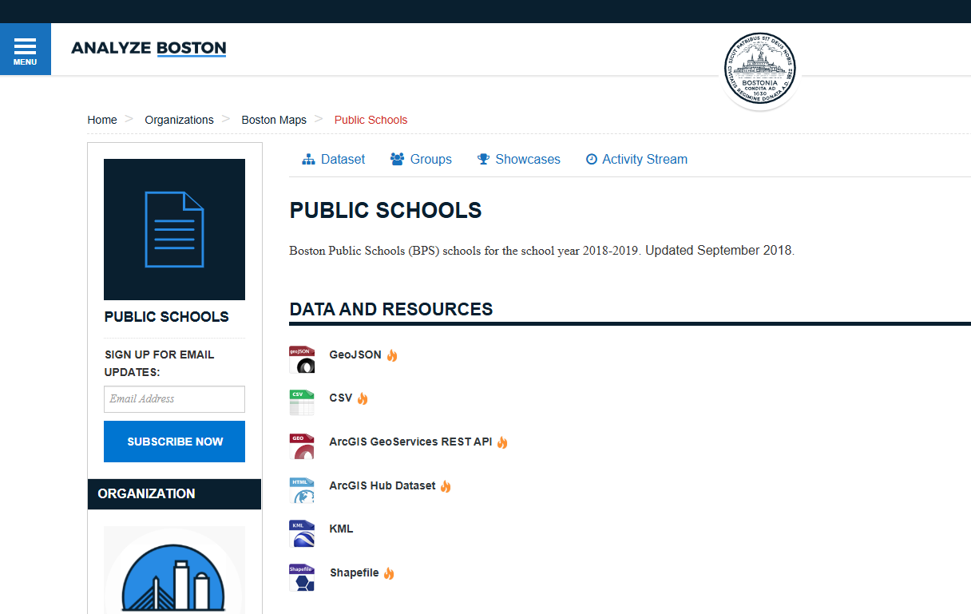
PUBLIC DATA
City of Boston
Others
City of San Francisco – SF OpenData
USGS, NOAA, Data.gov, US Census

Slide 44
DEMO #2

Slide 45

THINGS TO BLOW YOUR MIND

Slide 46

NEARMAP
Nearmap is a leading provider of high-resolution aerial imagery, offering frequent and up-to-date views of locations across the globe.
Their imagery is captured using advanced aircraft equipped with state-of-the-art cameras and sensors, providing clear, accurate, and detailed aerial images.
3D and Oblique Views
MapBrowser
https://www.nearmap.com/

Slide 47
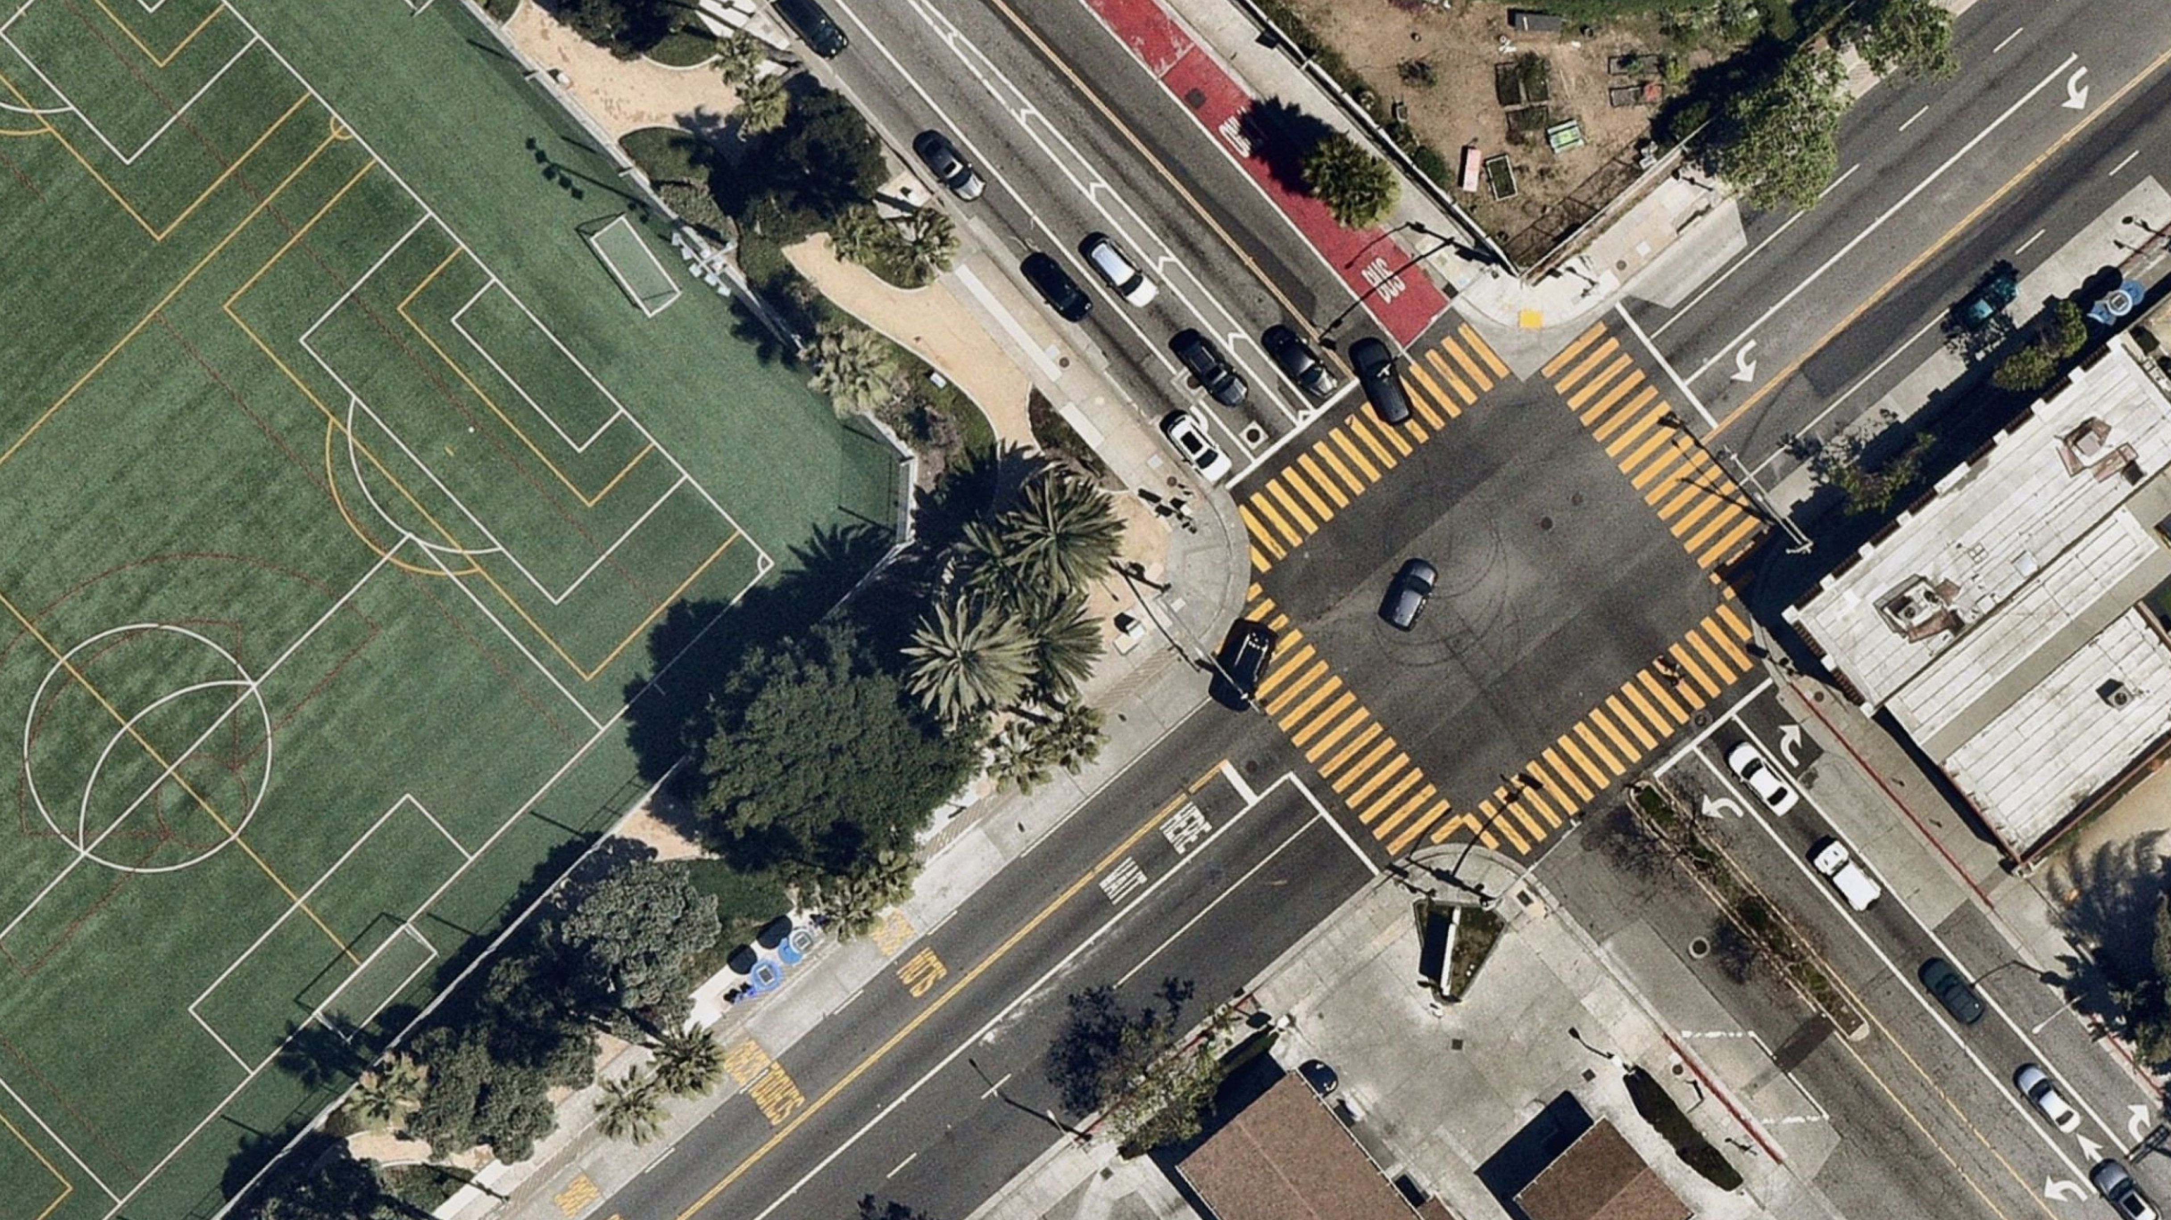
NEARMAP

Slide 48
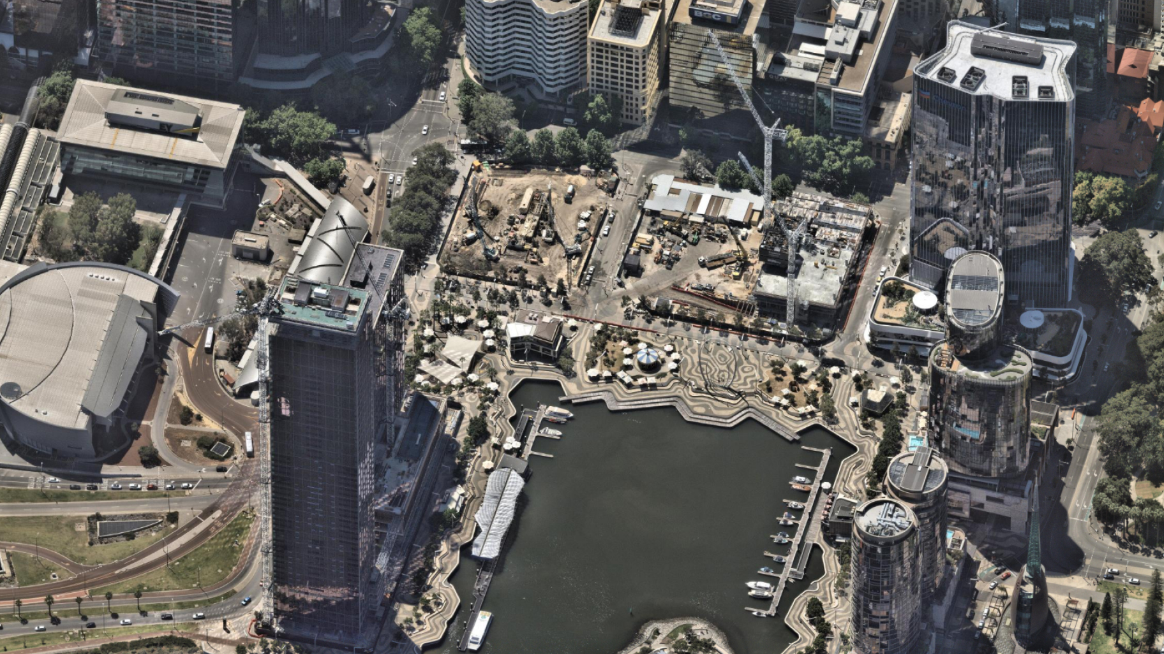
NEARMAP – OBLIQUE VIEW

Slide 49
GOOGLE 3D Photorealistic Tiles
“Photorealistic 3D Tiles are map tiles that contain Google's 3D geodata in the OGC 3D Tiles format. Google offers 3D Tiles for next-generation visualization use cases. You can use 3D Tiles to build stunning 3D perspective views.”
https://developers.google.com/maps/documentation/tile/3d-tiles-overview
https://cesium.com/learn/photorealistic-3d-tiles-learn/

Slide 50
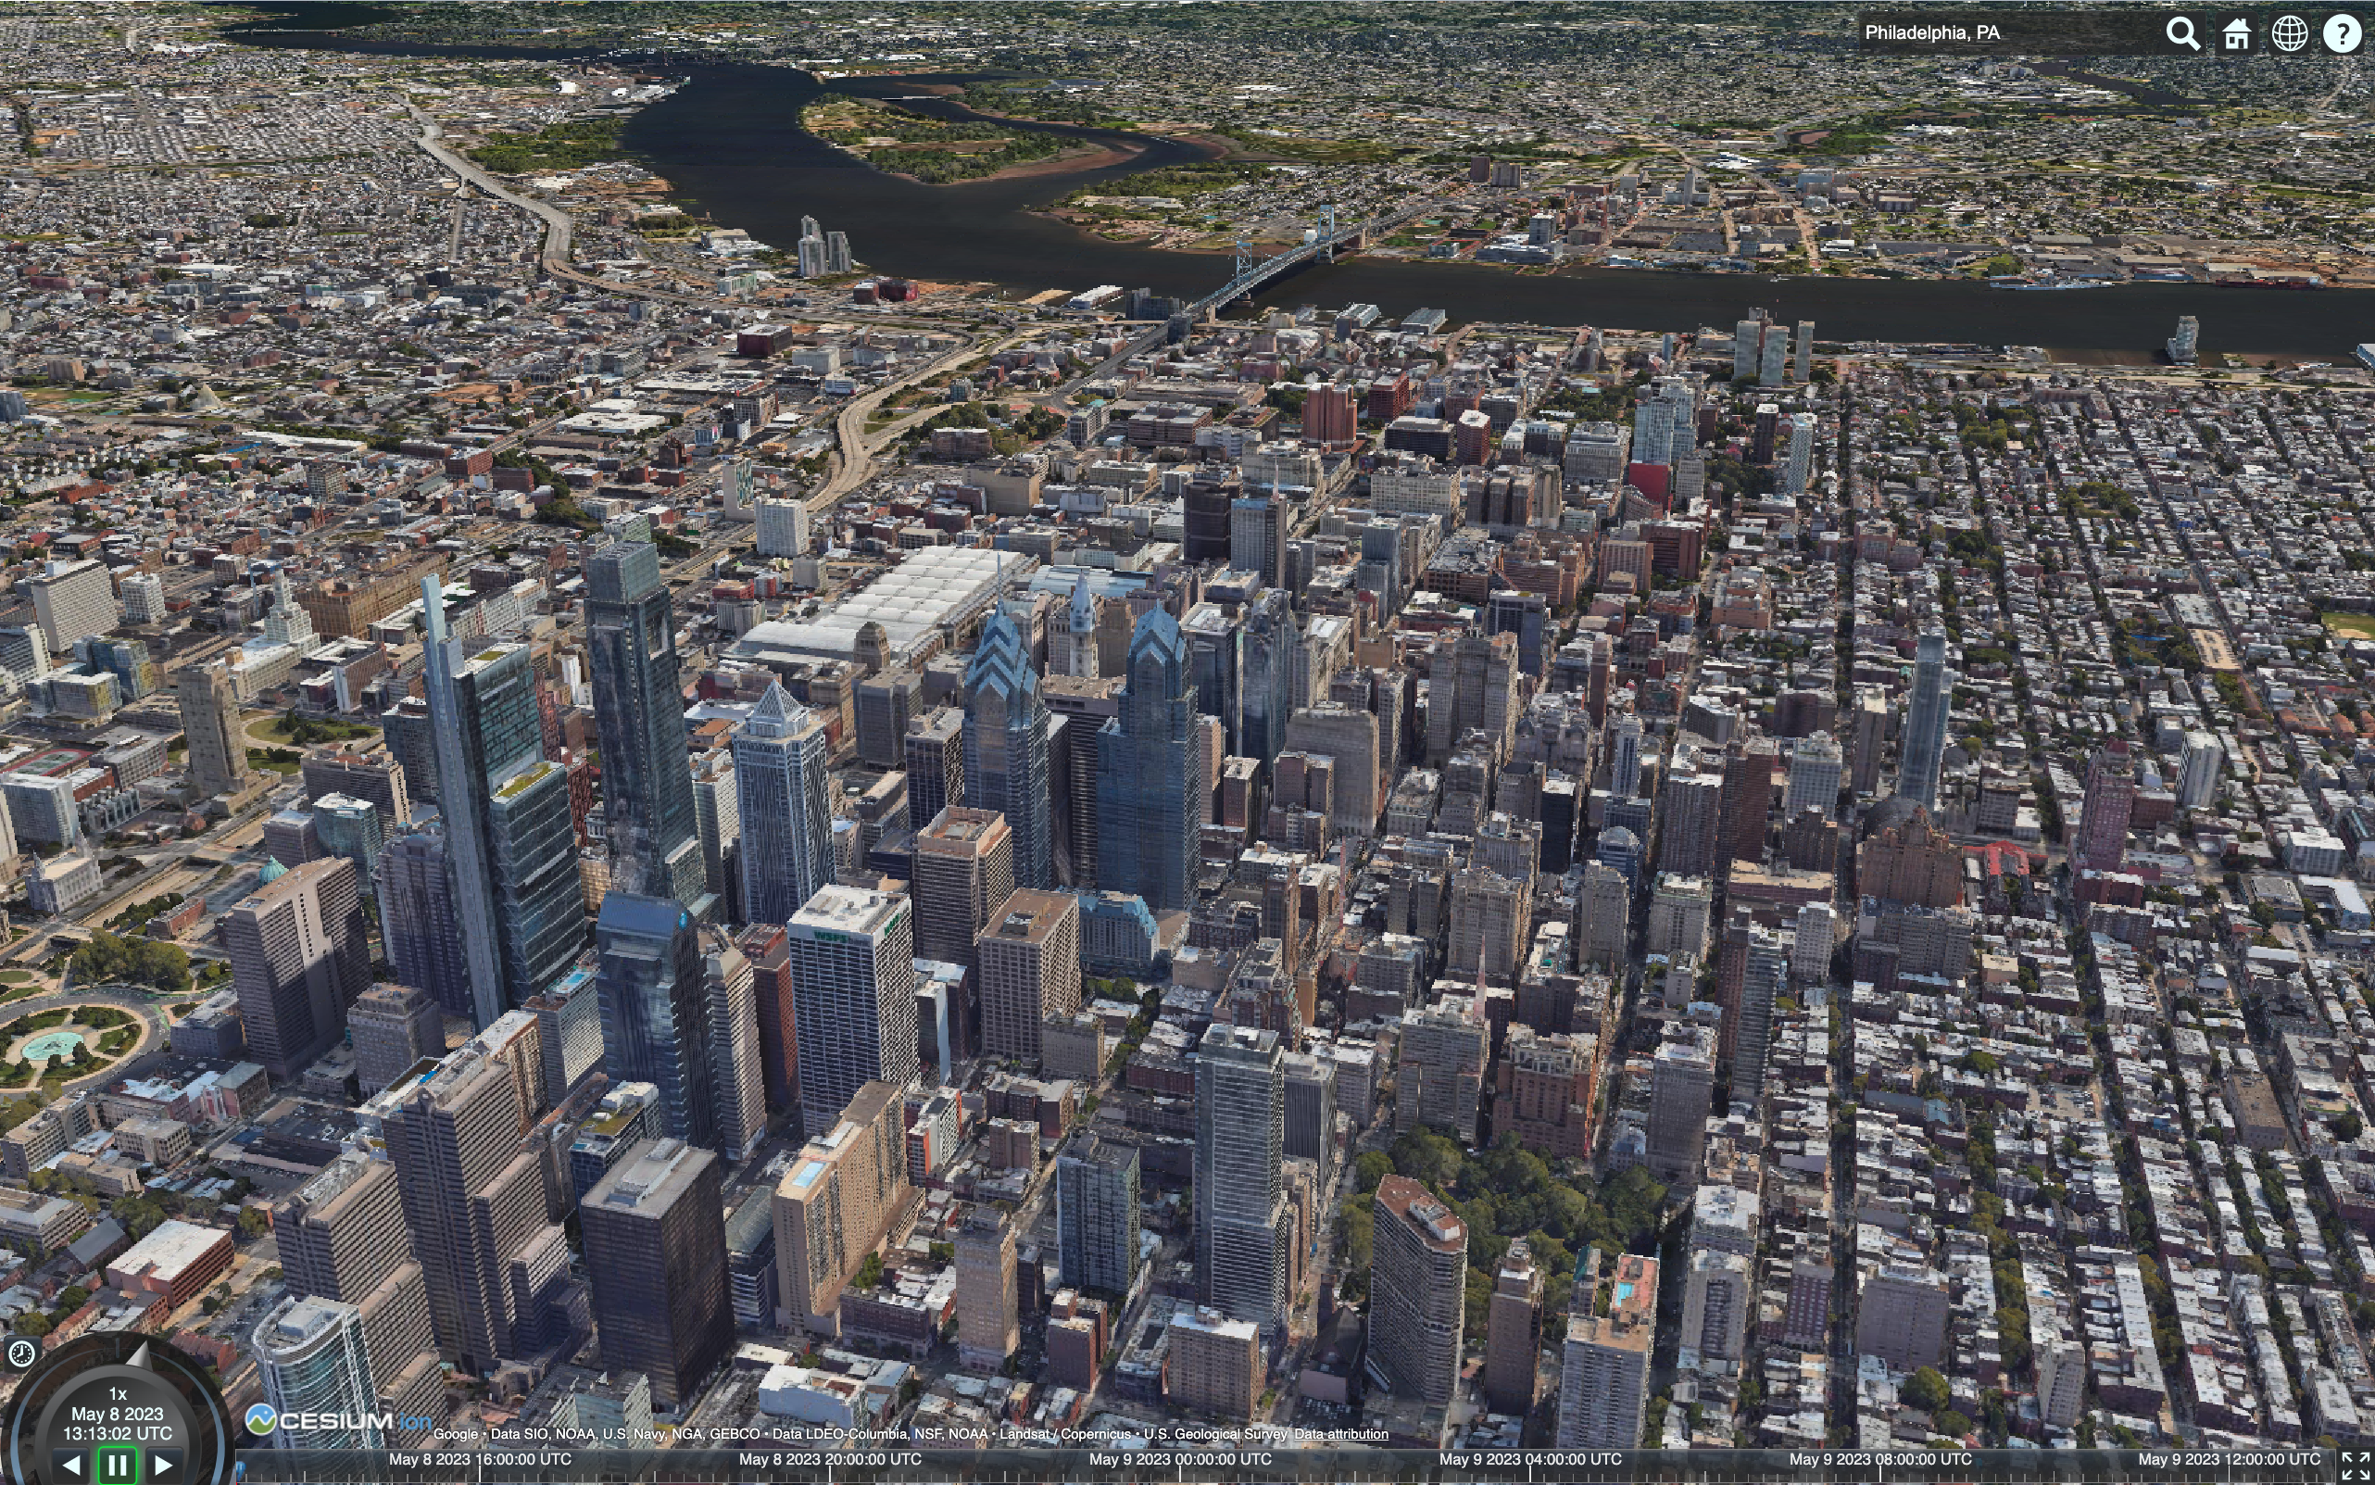
GOOGLE 3D Photorealistic Tiles

Slide 51
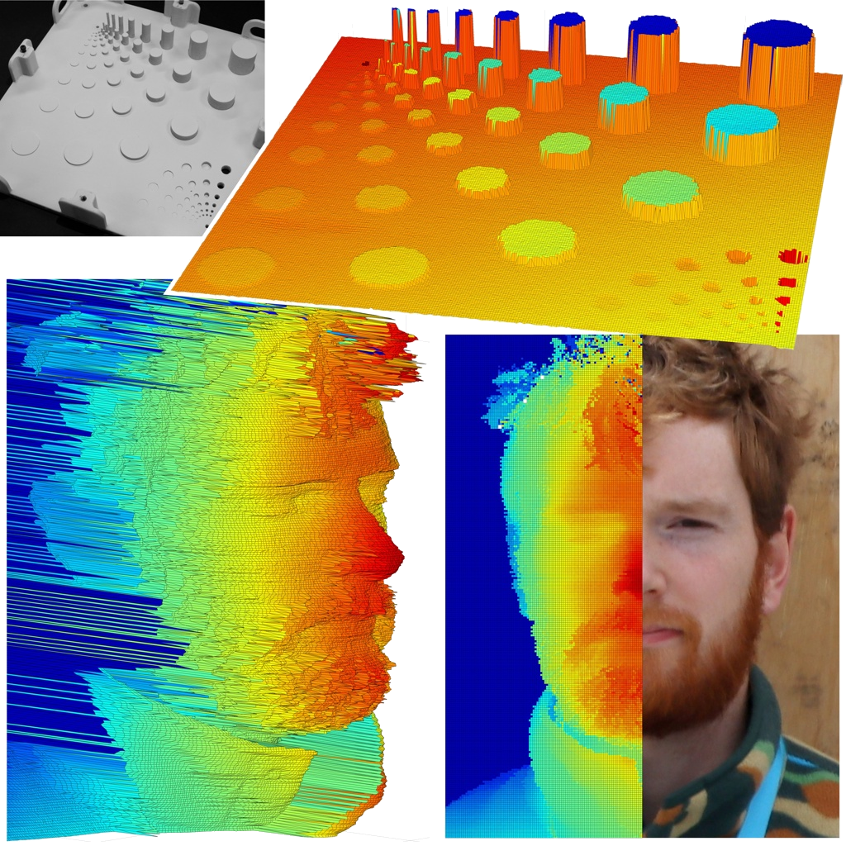
SINGLE PHOTON LIDAR
Single-photon LiDAR delivers detailed 3D images at distances up to 1 kilometer
While the field trials for the LiDAR system were limited to a range of 1 kilometer, researchers plan to test the system at distances of up to 10 km and explore imaging through atmospheric obscurants like smoke and fog. Future work will also focus on using advanced computational methods to accelerate data analysis and enable imaging of more distant scenes.
https://www.optica.org/about/newsroom/news_releases/2025/single-photon_lidar_delivers_detailed_3d_images_at_distances_up_to_1_kilometer/

Slide 52
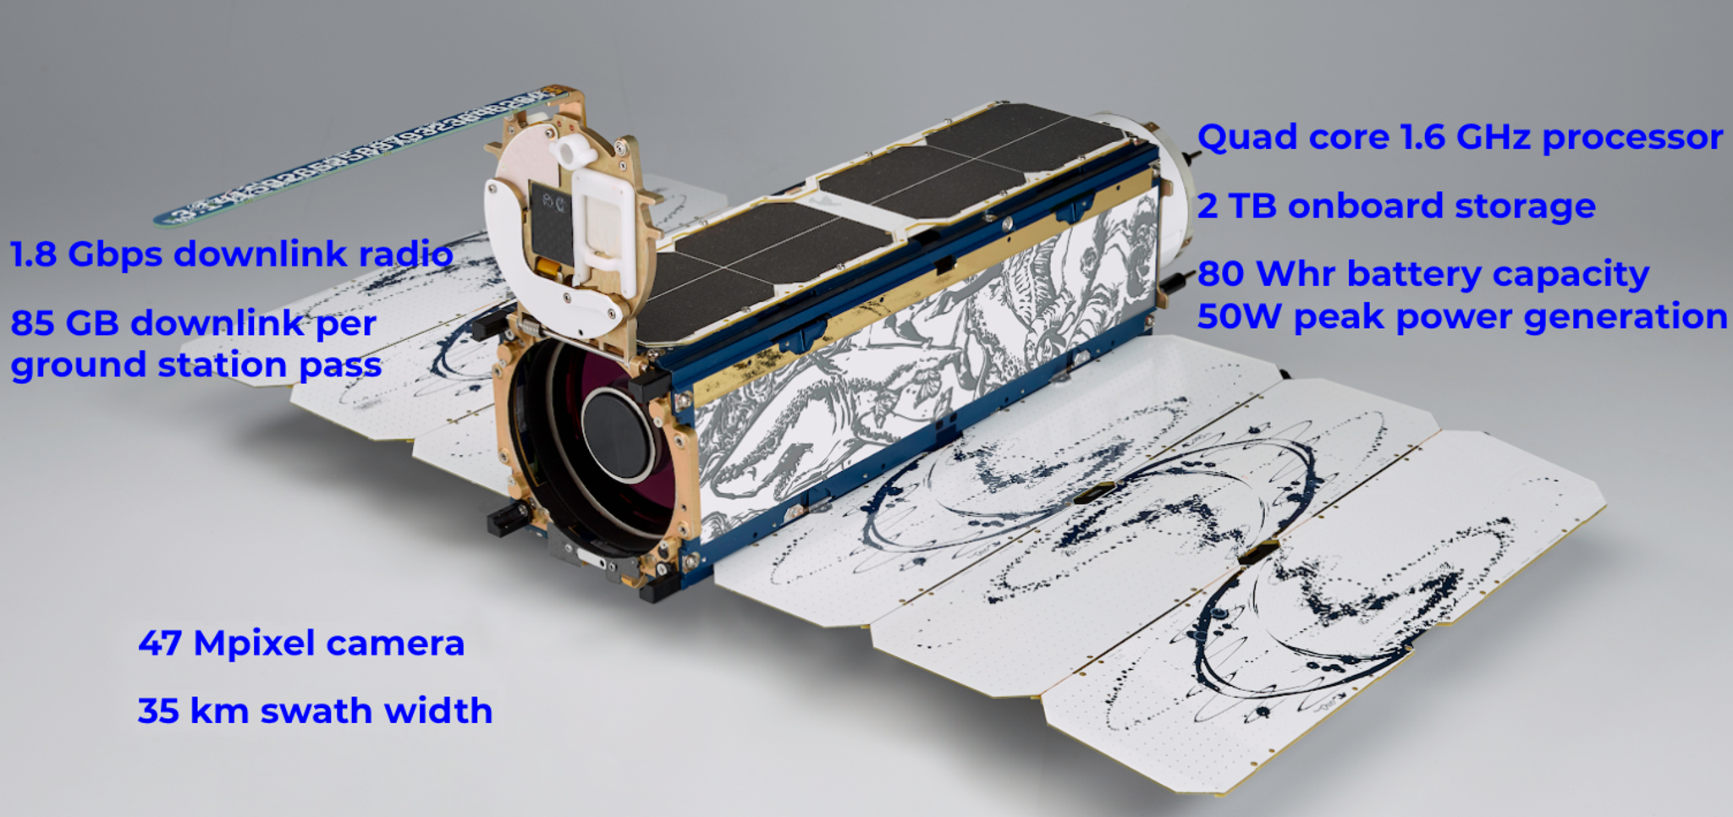
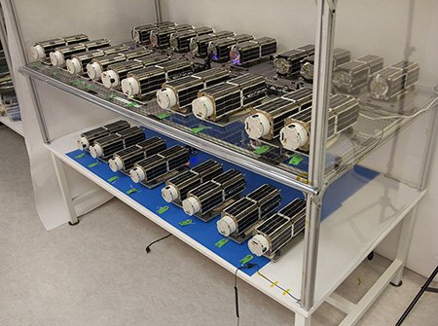
PLANET LABS
PlanetScope constellation consisting of hundreds of Dove® and SuperDove satellites.
Planet Monitoring provides near-daily, 3.7-meter resolution imagery covering all of Earth’s landmass. Access to these ready-to-use images is made simple with Planet’s APIs, web application, and GIS integrations. Available through a subscription model, Planet Monitoring can be scaled to the requirements of your analysis and application needs.
https://www.planet.com/

Slide 53
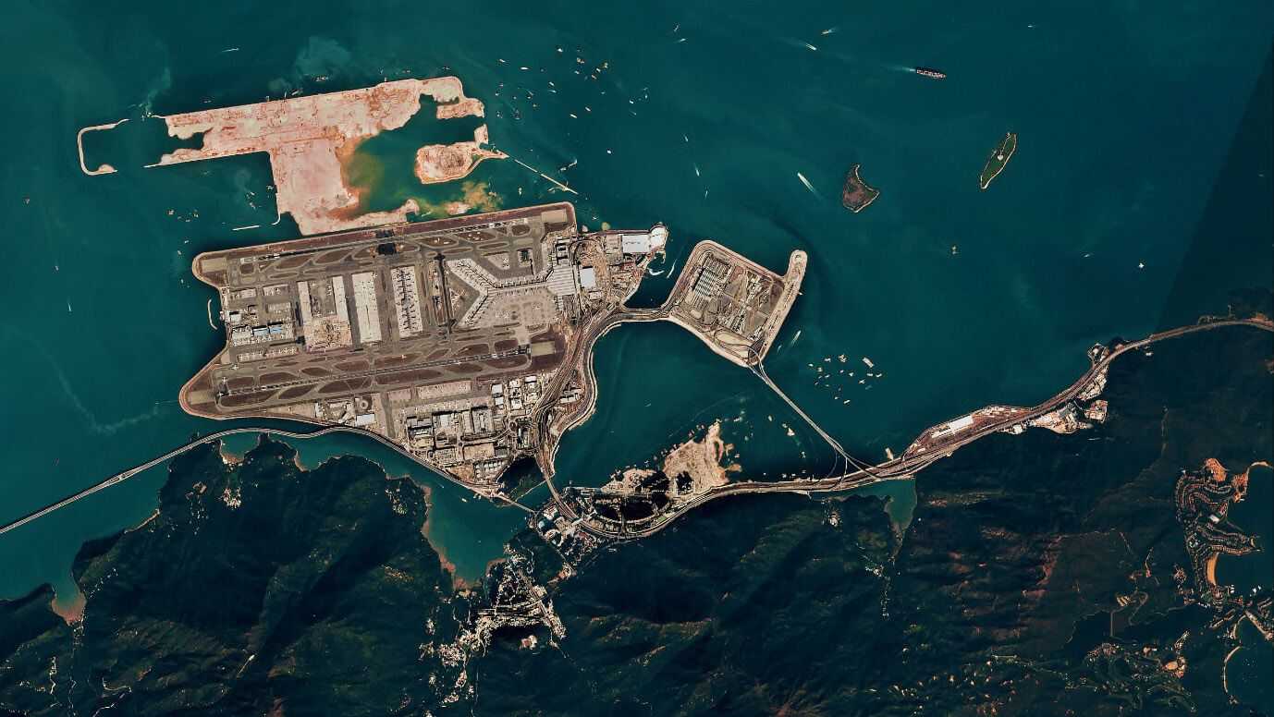
PLANET LABS

Slide 54

THANK YOU!

